Slide 1

Time Series in Frequency Domain
Dr. Abolfazl Saghafi
Assistant Professor of Statistics & Data Science
Notes:
This week we explore time series in frequency domain instead of time domain. This approach has many advantages that are widely appreciated in ﬁelds such as electrical engineering, geophysics and meteorology.

Slide 2
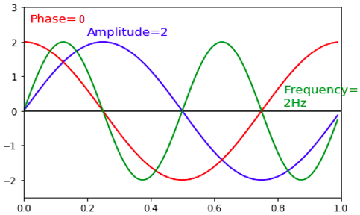

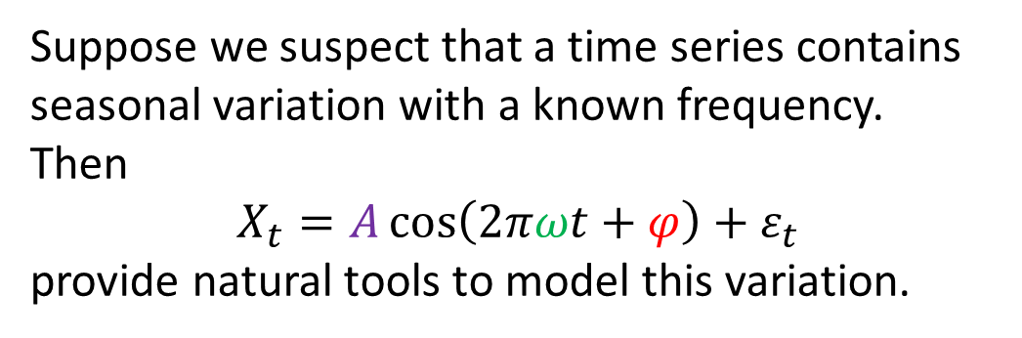
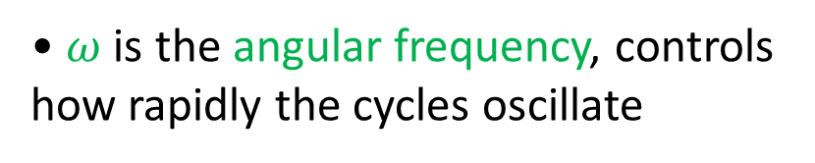
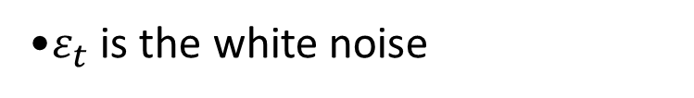
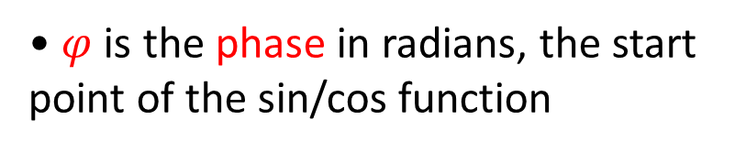
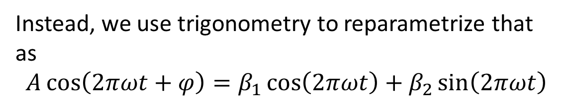
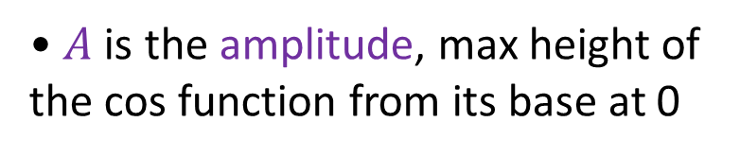
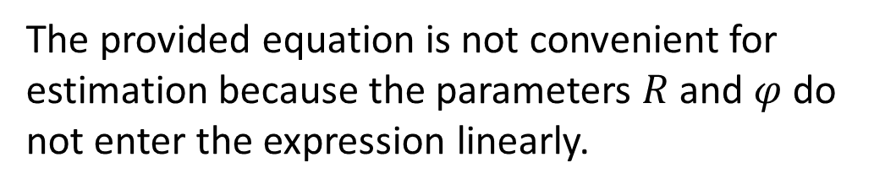
Frequency Domain
• $A$ is the amplitude, max height of the cos function from its base at 0
• $φ$ is the phase in radians, the start point of the sin/cos function
Suppose we suspect that a time series contains seasonal variation with a known frequency.
Then
$$X_{t}=A\cos\left(2πωt+φ\right)+ε_{t}$$
provide natural tools to model this variation.
• $ω$ is the angular frequency, controls how rapidly the cycles oscillate
•$ε_{t}$ is the white noise
The provided equation is not convenient for estimation because the parameters $R$ and $φ$ do not enter the expression linearly.
Instead, we use trigonometry to reparametrize that as
$$A\cos\left(2πωt+φ\right)=β_{1}\cos\left(2πωt\right)+β_{2}\sin\left(2πωt\right)$$
where $β_{1}=A\cos{φ}$, $β_{2}=−A\sin{φ}$.
Notes:
In week 3, we learned that seasonal variations can be modeled using sin and cosine functions. Here, we explore that possibility further. Suppose we …
Equivalently, $A=\sqrt{β_{1}^{2}+β_{2}^{2}}$, $φ=\operatorname{atan}{(−β_{2}/β_{1})}$
Angular frequency ($ω$) is different from what we defined earlier. It is the number of full cycles per unit of time. When working in Hz, it is the number of complete cycles within 1 second. In the examples above, the blue and red waves has an angular frequency of 1 and the green wave has an angular frequency of 2. What we used before is known as period or wavelength, that is the duration of one cycle in a repeating event, the period is the reciprocal of angular frequency, period = 1/$ω$.

Slide 3
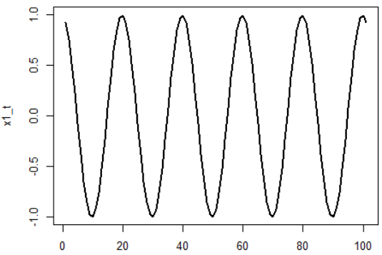
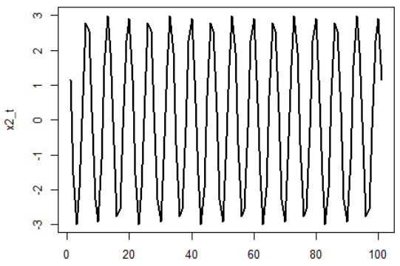
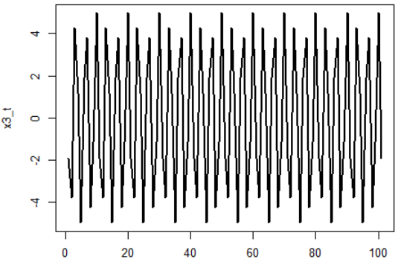
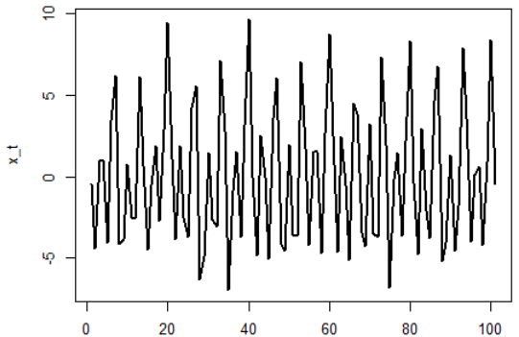
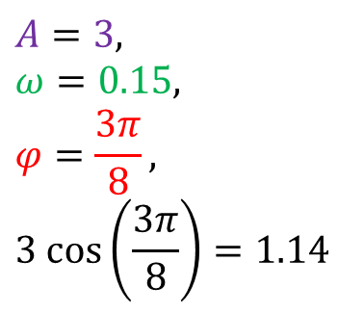
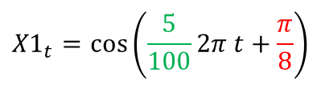
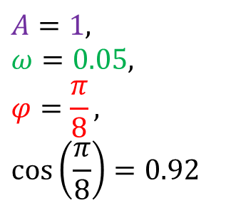

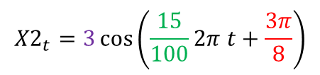
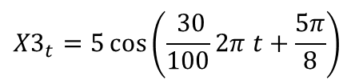
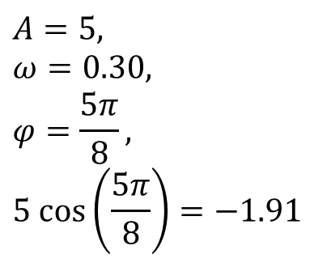
$${X1}_{t}=\cos\left(\frac{5}{100}2π t+\frac{π}{8}\right)$$
$${X2}_{t}=3\cos\left(\frac{15}{100}2π t+\frac{3π}{8}\right)$$
$$A=1,$$
$$ω=0.05,$$
$$φ=\frac{π}{8},$$
$$\cos\left(\frac{π}{8}\right)=0.92$$
$$A=3,$$
$$ω=0.15,$$
$$φ=\frac{3π}{8},$$
$$3 cos\left(\frac{3π}{8}\right)=1.14$$
$${X3}_{t}=5\cos\left(\frac{ 30}{100}2π t+\frac{5π}{8}\right)$$
$$X_{t}=X_{1t}+X_{2t}+X_{3t}+ε_{t}$$
$$A=5,$$
$$ω=0.30,$$
$$φ=\frac{5π}{8},$$
$$5 cos\left(\frac{5π}{8}\right)=−1.91$$
In depth investigations could reveal existing of three cyclic patterns.
Notes:
Here I have some simulated parodic patterns using the cosine function. You can see the transformed version into sin/cos in the transcript. Looking at the first one, we do not have any added noise there. Amplitude is 1, since the waves go up to 1 while fluctuating around 0, angular frequency is 0.05, which is the term multiplied to 2πt, phase is π/8, and you can see cos(π/8) is 0.92, that’s where the series starts, at time 0.
The last time series looks more real, something that you could see in real examples. That take us to the next topic, the generalization of the formula we discussed.
$${X1}_{t}=\cos\left(\frac{5}{100}2π t+\frac{π}{8}\right)=\cos\left(\frac{π}{8}\right)\cos\left(\frac{5}{100}2π t\right)−\sin\left(\frac{π}{8}\right)\sin\left(\frac{5}{100}2π t\right)$$

Slide 4
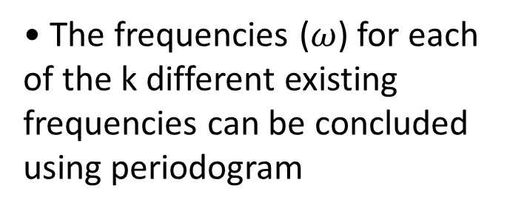
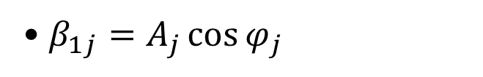
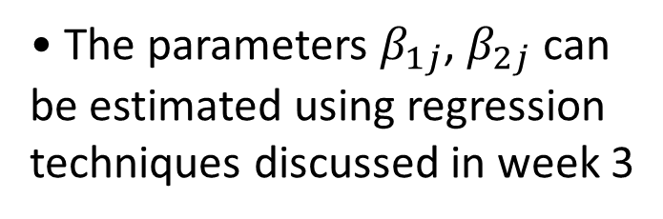
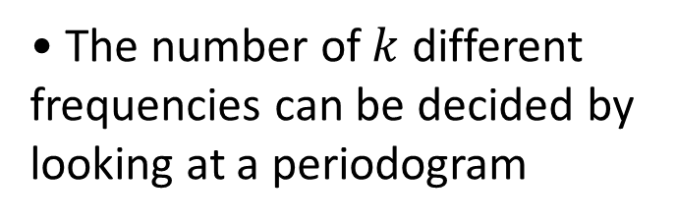
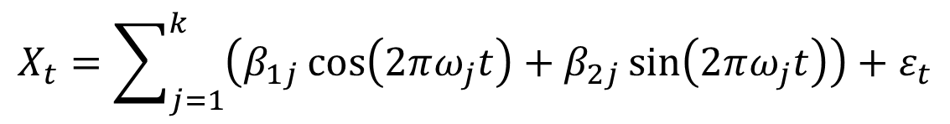
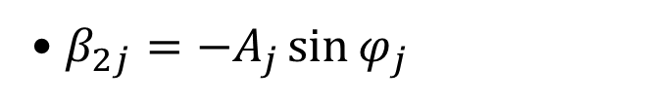
General Formulation
• $β_{1j}=A_{j}\cos{φ_{j}}$
• $β_{2j}={−A}_{j}\sin{φ_{j}}$
In practice, seasonal variation in a time series may be caused by variation at several diﬀerent frequencies. That is, a time series may contain weekly, monthly, yearly and other cyclical variation on top of each other.
• The number of $k$ different frequencies can be decided by looking at a periodogram
• The frequencies ($ω$) for each of the k different existing frequencies can be concluded using periodogram
It is therefore natural to generalize the aforementioned equation to
$$X_{t}=\sum_{j=1}^{k}{\left(β_{1j}\cos\left(2πω_{j}t\right)+β_{2j}\sin\left(2πω_{j}t\right)\right)}+ε_{t}$$
• The parameters $β_{1j}$, $β_{2j}$can be estimated using regression techniques discussed in week 3
where it assumes existence of k different frequencies.
Notes:
While the amplitude, phase and angular frequency of a simple cosine function can be deduced visually pretty easily, it gets tricky when more complicated cases are presented, such as the case with $X_{t}$ in previous example.
What do I mean by these statements? What is a periodogram?

Slide 5
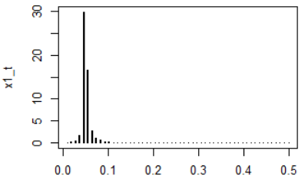
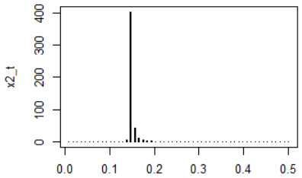
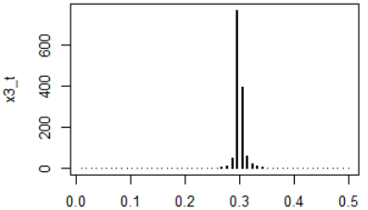
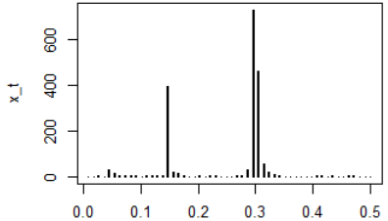
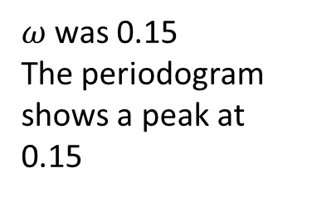
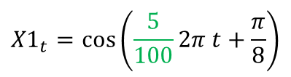
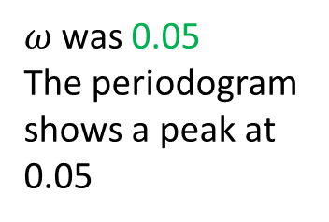
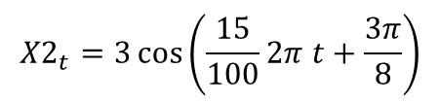
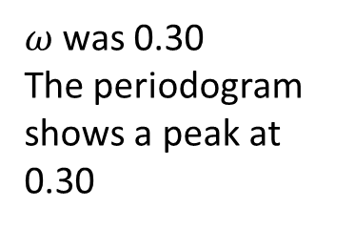
$${X1}_{t}=\cos\left(\frac{5}{100}2π t+\frac{π}{8}\right)$$
$${X2}_{t}=3\cos\left(\frac{15}{100}2π t+\frac{3π}{8}\right)$$
$ω$ was 0.05
The periodogram shows a peak at 0.05
$ω$ was 0.15
The periodogram shows a peak at 0.15
$${X3}_{t}=5\cos\left(\frac{ 30}{100}2π t+\frac{5π}{8}\right)$$
$$X_{t}=X_{1t}+X_{2t}+X_{3t}+ε_{t}$$
$ω$ was 0.30
The periodogram shows a peak at 0.30
The periodogram shows three peaks at 0.05, 0.15, and 0.30
Notes:
Here, I have periodograms of the simulated patterns in the previous example. Looking at the first one, see how periodogram has a peak at 0.05, angular frequency was 0.05 in that example.
Periodogram seems to be working, but what is a periodogram and how it is computed?

Slide 6
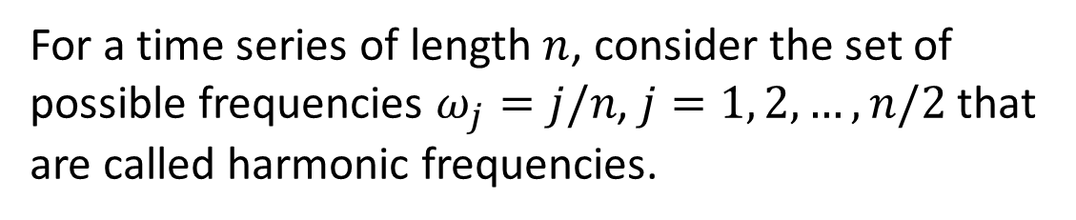

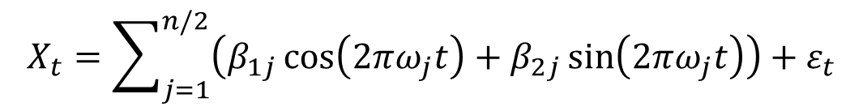
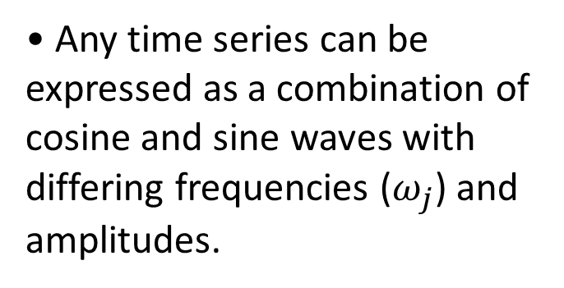
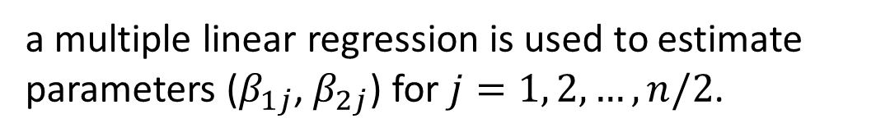
Periodogram
• Any time series can be expressed as a combination of cosine and sine waves with differing frequencies ($ω_{j}$) and amplitudes.
For a time series of length $n$, consider the set of possible frequencies $ω_{j}=j/n$, $j=1, 2, …, n/2$ that are called harmonic frequencies.
• A periodogram is used to identify the dominant frequencies of a time series. This can be a helpful tool particularly when the cycles are not related to the commonly encountered monthly or quarterly seasonality.
After representing the time series as
$$X_{t}=\sum_{j=1}^{n/2}{\left(β_{1j}\cos\left(2πω_{j}t\right)+β_{2j}\sin\left(2πω_{j}t\right)\right)}+ε_{t}$$
a multiple linear regression is used to estimate parameters ($β_{1j}$, $β_{2j}$) for $j=1, 2, …, n/2$.
The scaled periodogram is
$$P\left(j/n\right)=\left({β_{1j}}^{2}+{β_{2j}}^{2}\right)\left(\frac{n}{2}\right)$$
Notes:
Any time series can be expressed as a combination of cosine and sine waves with differing frequencies ($ω_{j}$) and amplitudes. That is a theorem and the idea behind Fourier transformations.
Large values of P(j/n) indicate which frequencies are predominant in the series, whereas small values of P(j/n) may be associated with noise.

Slide 7
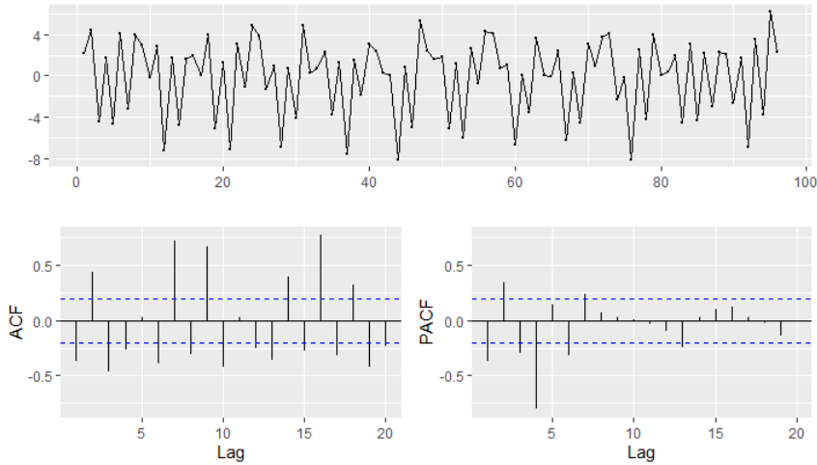
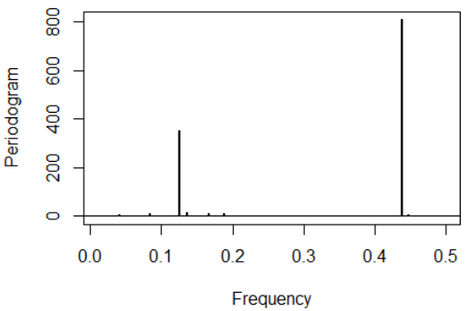
Example 2
The time plot shows a simulated non-stationary time series that includes additive white noise and seasonal variation [1].
Investigate the periodogram and decide on the number of and value of different frequencies to model the cyclic pattern.
The periodogram clearly shows that the series contains two cosine-sine pairs at frequencies of around 0.12 and 0.44 and that the higher-frequency component is much stronger.
There are some other very small spikes in the periodogram, apparently caused by the additive white noise component.
[1] Jonathan Cryer & Kung-sik Chan, Time Series Analysis: With Applications in R by, Springer, 2008.
Notes:
Here we see examples on how periodogram can be used to detect seasonal variation with their frequencies in time series.
Looking at the time plot here, there some cyclic patterns in the time series, the ACF also reveals non-stationarity but detecting frequency of the cyclic pattern is not easy in this case.

Slide 8
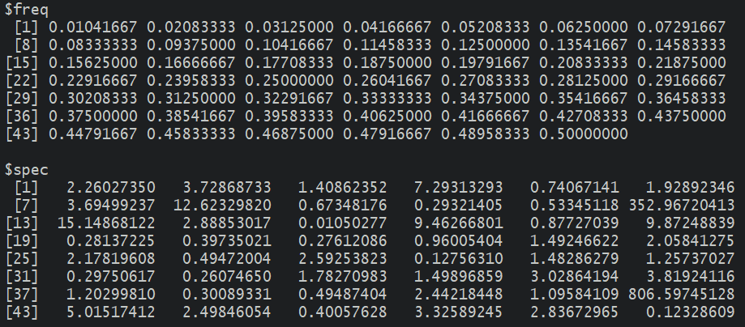
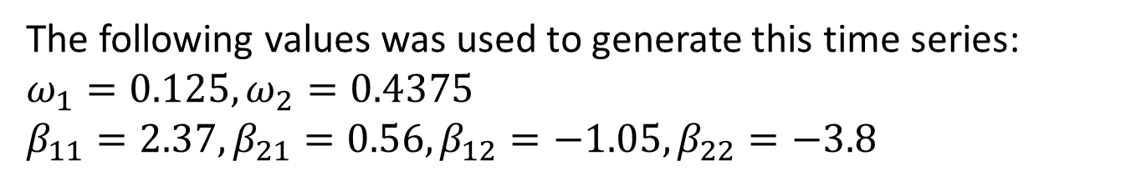
Periodogram results show the two high peaks 806.6 and 353 at frequencies 0.125 and 0.438
I used the following equation to simulate this time series that has two different cyclic patterns with random frequencies:
$$X_{t}=β_{11}\cos\left(2πω_{1}t\right)+β_{21}\sin\left(2πω_{1}t\right)+β_{12}\cos\left(2πω_{2}t\right)+β_{22}\sin\left(2πω_{2}t\right)+ε_{t}$$
The coefficients were also randomly generated.
The following values was used to generate this time series:
$$ω_{1}=0.125,ω_{2}=0.4375$$
$$β_{11}=2.37,β_{21}=0.56,β_{12}=−1.05,β_{22}=−3.8$$
You can see that the estimated frequencies are very close to the actual values used for the simulation.
Notes:
The catch from this example is that the periodogram work just as well when we do not know where or even if there are cosines in the series, even when the series contains additional noise.

Slide 9
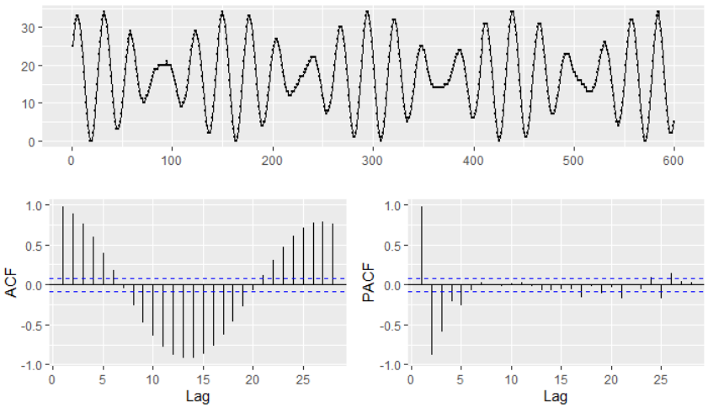
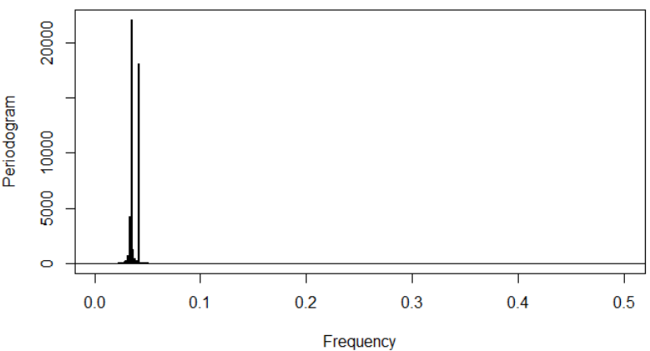
Example 3
The time plot shows real data on star brightness for 600 consecutive nights [1].
It is obviously a non-stationary TS and must have seasonal variation(s) but the frequency(ies) is not clear from these charts.
There are two very prominent peaks in the periodogram at frequencies 0.035 and 0.04167.
These frequencies correspond to 1/0.035≈29 days and 1/0.04167≈24 days.
[1] Whittaker, E. T., and Robinson, G. The Calculus of Observations. English Universities Press, London, 1924.
Notes:
When I checked the

Slide 10
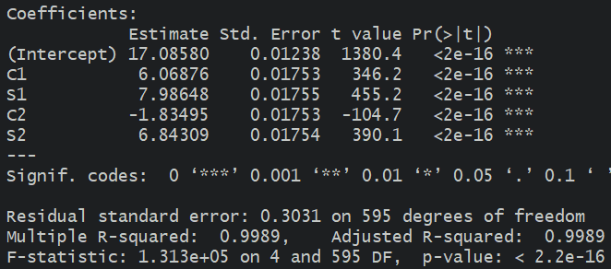
The two sharp peaks suggest a model for this series with just two cosine-sine pairs with the two frequencies $\left(ω_{1}=\frac{1}{29}, ω_{2}=\frac{1}{24}\right)$:
$$X_{t}=β_{0}+β_{11}\cos\left(2πω_{1}t\right)+β_{21}\sin\left(2πω_{1}t\right)+β_{12}\cos\left(2πω_{2}t\right)+β_{22}\sin\left(2πω_{2}t\right)+ε_{t}$$
We can now proceed with estimating parameters ($β$) and removing the seasonal variation, the way we discussed in week 3.
Estimated βs are all significant, and the regression model achieves 99.89% adjusted R².
After removing the seasonal variation, the residuals still have some more remaining cyclic patterns.
We can try to remove them by following the same process, need to stop at some point though, or use the found regression model, Adj-R² of 99.89% is great, for extrapolation, as opposed to forecasting. Must be careful about extrapolation though.
Notes:
The forecasted values were 0, 2, 5, 9, 13, 17, 21 for the next seven nights

Slide 11
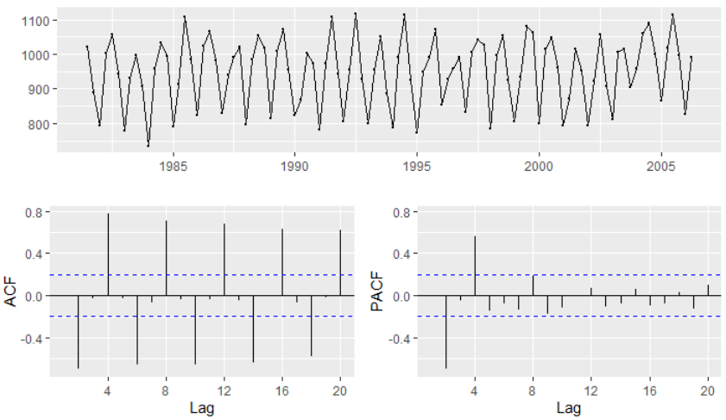
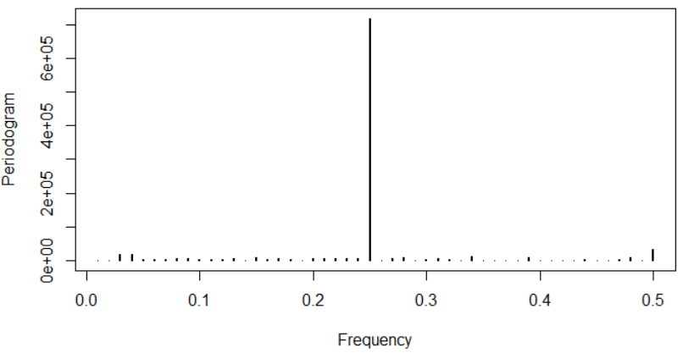
Example 4
Quarterly sales for a small company over the period 1981-2005 is shown in the time plot [2].
Obviously non-stationary with seasonal variation.
The periodogram reveals one strong frequency at 0.25 that corresponds to 1/0.25 = 4 period, which makes sense since the data is quarterly data.
The rest of the frequencies are not large even at a log-scale graph, so we decide to continue with one sin-cos representation of the seasonal variation.
[2] Rob Hyndman and George Athanasopoulos, Forecasting: Principles and Practice, Monash University, Australia, 2013.
Notes:
When I checked the

Slide 12
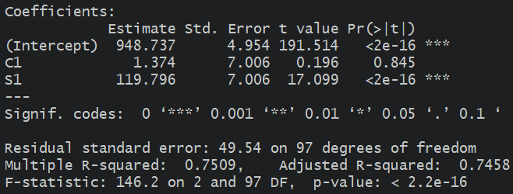
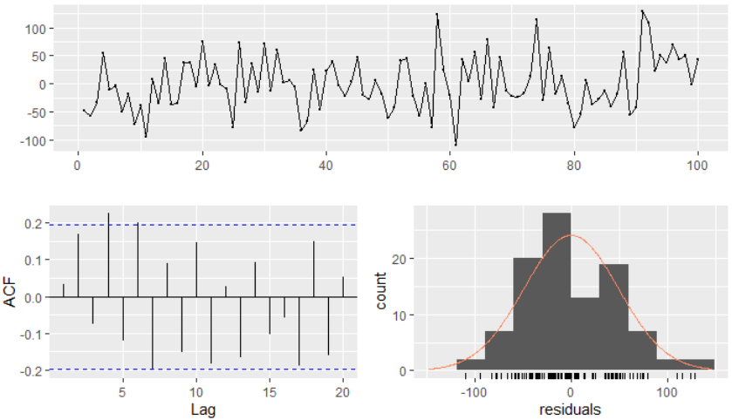
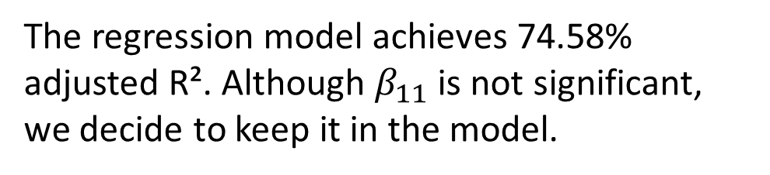
Therefore, the following model is fitted to the data and parameters are estimated.
$$X_{t}=β_{0}+β_{11}\cos\left(2πt/4\right)+β_{21}\sin\left(2πt/4\right)+ε_{t}$$
The regression model achieves 74.58% adjusted R². Although $β_{11}$ is not significant, we decide to keep it in the model.
The residuals of the model demonstrate white noise properties. All tests also confirm the four required criteria for residuals.
We can follow the cross-validation process discussed in week 8. A white noise will have a smaller GOF measures than alternative models.
Therefore, the above model is good enough for extrapolation, even forecasting.
Notes:
Extrapolations generate values of 1069, 947, 829, and 950 thousand dollars in sales for the next four seasons.

Slide 13
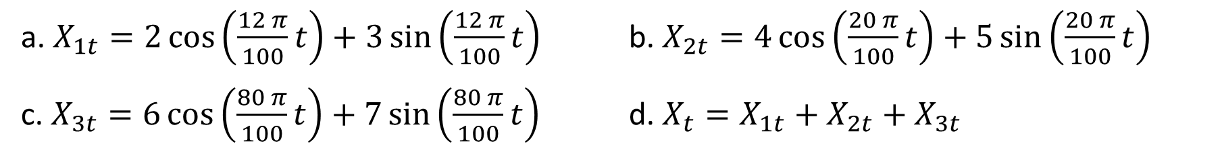
Practice Problems
1. Generate the following time series and plot them for t = 1, 2, …, 100. Then generate their periodogram and confirm their angular frequency.
a. $X_{1t}=2\cos\left(\frac{12 π}{100}t\right)+3\sin\left(\frac{12 π}{100}t\right)$ b. $X_{2t}=4\cos\left(\frac{20 π}{100}t\right)+5\sin\left(\frac{20 π}{100}t\right)$
c. $X_{3t}=6\cos\left(\frac{80 π}{100}t\right)+7\sin\left(\frac{80 π}{100}t\right)$ d. $X_{t}=X_{1t}+X_{2t}+X_{3t}$
2. CVDdaily dataset provides daily number of deaths from cardiovascular disease (CVD) in people aged 75 and over in Los Angeles for the years 1987 to 2000.
a. Import the data into your session and discuss stationarity of variable cvd.
b. Graph periodogram and decide on dominant existing (if) frequency(ies).
c. Develop a proper sin/cos model and estimate model parameters.
d. Perform residual analysis and check required assumptions regarding residuals.
e. Decide what steps to take next.
Notes:
Q1.
t <- seq(1,100)
x1_t = 2*cos(2*pi*6/100*t)+ 3*sin(2*pi*6/100*t)
x2_t = 4*cos(2*pi*10/100*t)+5*sin(2*pi*10/100*t)
x3_t = 6*cos(2*pi*40/100*t)+7*sin(2*pi*40/100*t)
x_t = x1_t + x2_t + x3_t
par(mfrow=c(2,2))
plot.ts(x1_t, ylim=c(-10,10), main=expression(omega==0.06~~~A^2==13))
plot.ts(x2_t, ylim=c(-10,10), main=expression(omega==0.10~~~A^2==41))
plot.ts(x3_t, ylim=c(-10,10), main=expression(omega==0.40~~~A^2==85))
plot.ts(x_t, ylim=c(-16,16), main="sum")
par(mfrow=c(1,1))
par(mfrow=c(2,2))
periodogram(x1_t, ylab="x1_t")
periodogram(x2_t, ylab="x2_t")
periodogram(x3_t, ylab="x3_t")
periodogram(x_t, ylab="x_t")
par(mfrow=c(1,1))

